Slide 1
Transparency and Accountability in Asset Recovery
25 November 2020
Mathias Huter
Managing Director
mathias.huter@uncaccoalition.org
uncaccoalition.org
info@uncaccoalition.org

Slide 2
About the UNCAC Coalition
A global network of over 350 CSOs and individual members in more than 100 countries
Committed to advancing the ratification, implementation and monitoring of the UN Convention against Corruption (UNCAC) to combat corruption
Founded in 2006 as an informal network
Coalition opened its permanent office in Vienna in 2019
uncaccoalition.org
info@uncaccoalition.org

Slide 3
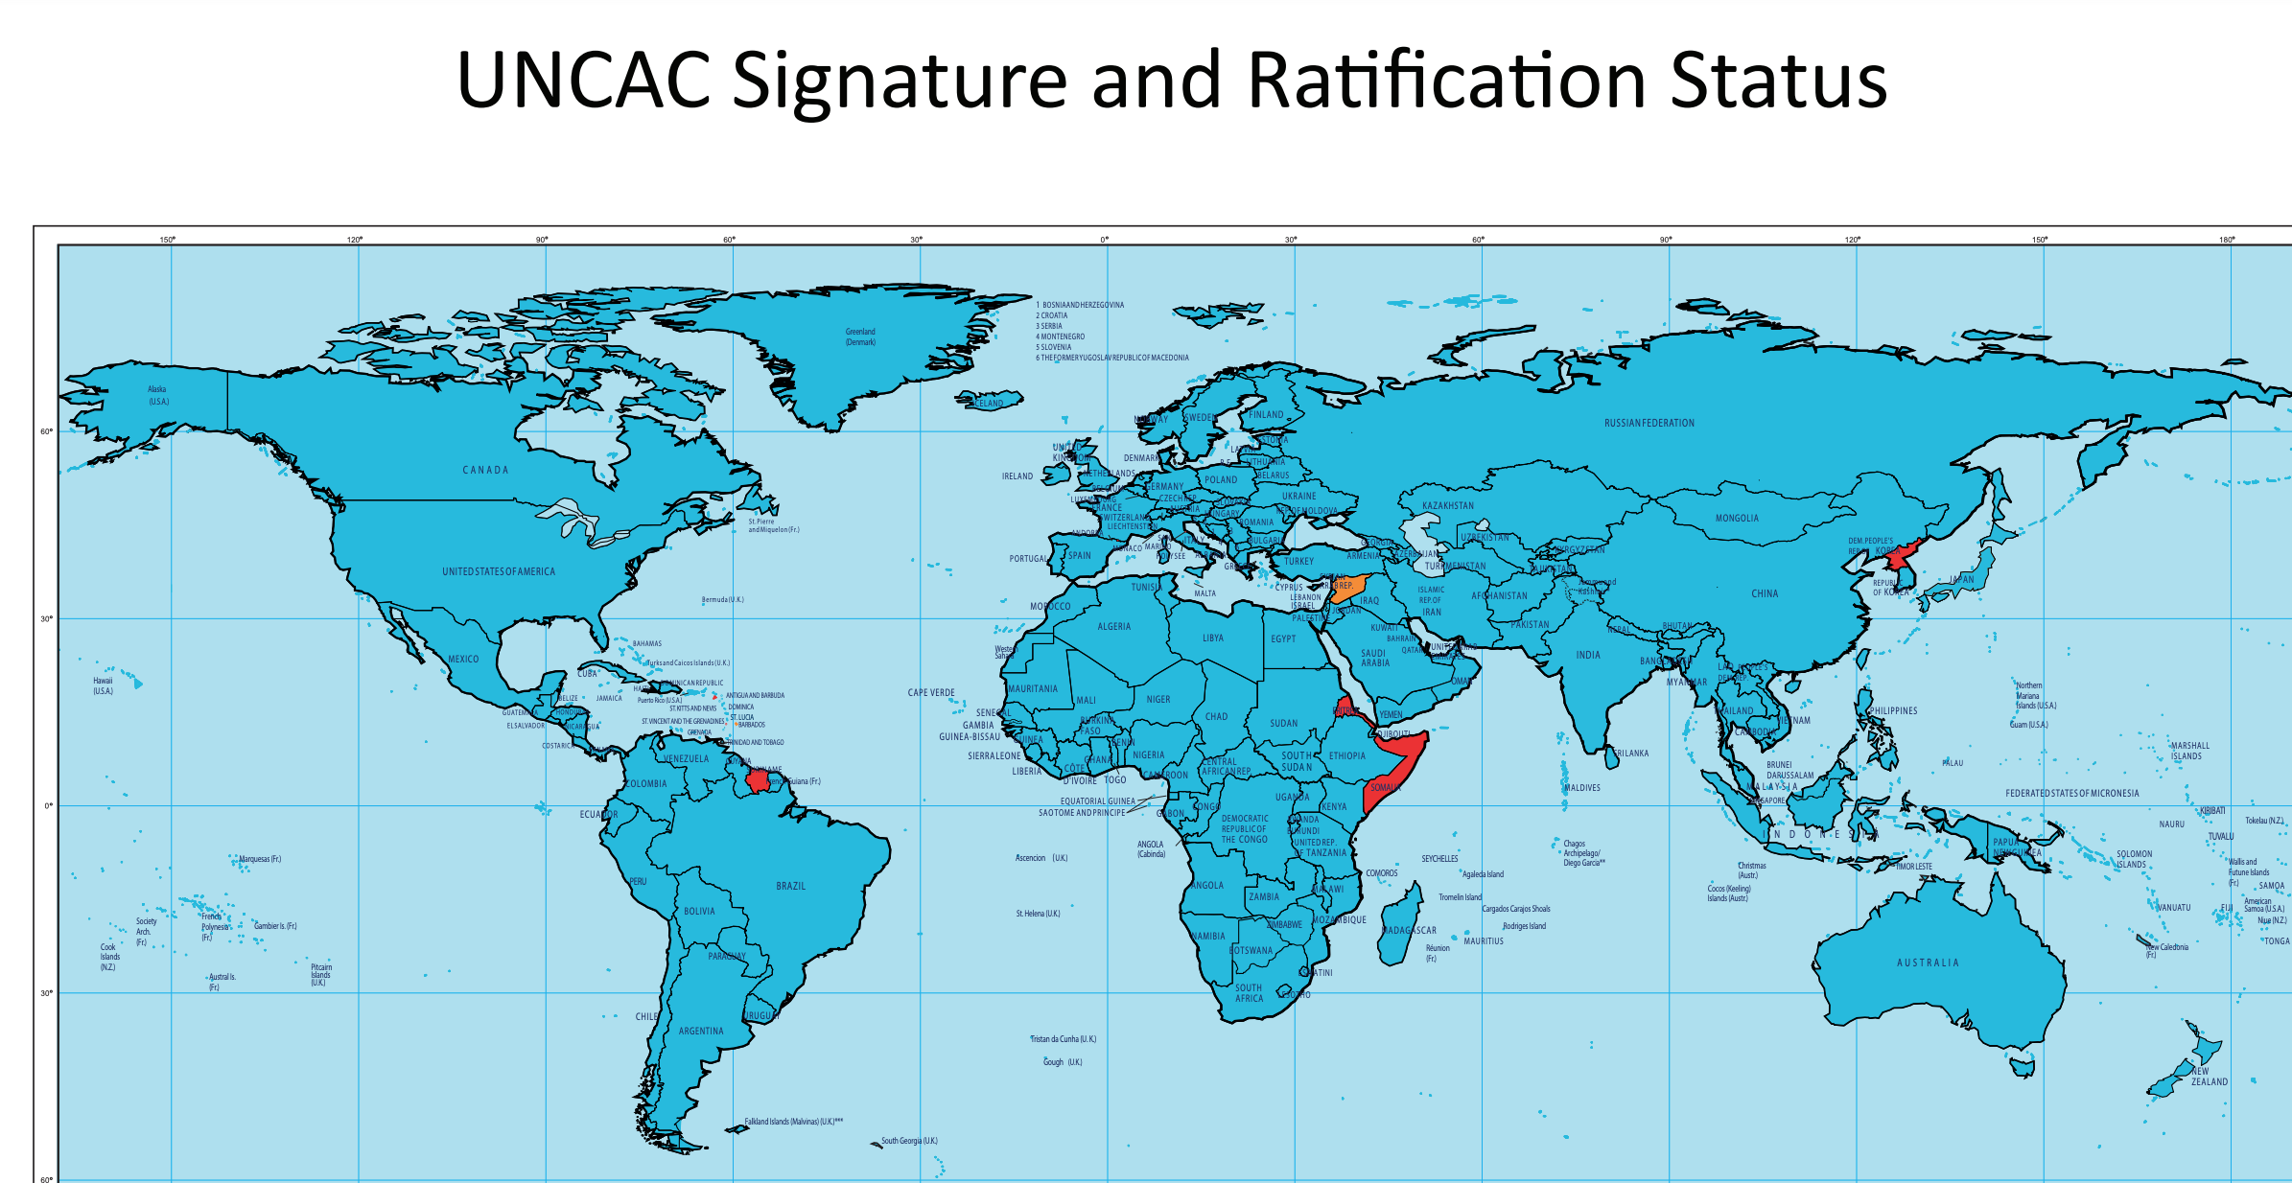
The UNCAC – Introduction
Adopted by the UN GA in October 2003, entered into force in December 2005
15 years – still lots of progress needed to implement the Convention
Secretariat: UNODC in Vienna
Only global binding anti-corruption instrument
187 States Parties
uncaccoalition.org
info@uncaccoalition.org

Slide 4
Why is the UNCAC important?
Framework for international cooperation (Chapter IV)
criminal matters, investigations, proceedings in civil and administrative matters – addresses cross-border nature of corruption
Framework for return of the proceeds of corruption (Chapter V)
Convention does not define corruption, but a series of offenses that should be criminalised
uncaccoalition.org
info@uncaccoalition.org

Slide 5
Chapter V – Asset Recovery
Return of proceeds from corruption to its country of origin as a “fundamental principle” (Article 51)
States Parties are required to “afford one another the widest measure of cooperation and assistance in this regard”
In practice: question of conditions for the return of assets is a very contagious issue
Convention implies that no conditions are to be imposed for asset return
States returning assets seek to ensure that returned assets are not misappropriated or stolen again
Goal: ensuring transparent and accountable process, including by involving civil society
uncaccoalition.org
info@uncaccoalition.org

Slide 6
Transparency & Accountability Good practices in asset return
States involved in asset recovery cases sign bilateral agreements
Agreements should be public
Both States involved should publish data, information, court decisions, agreements, transaction data etc. related to asset recovery case
Clear and independent monitoring and oversight procedures should be in place
Procedures should ensure that funds are used to benefit population and are not misappropriated
Civil society should play an important role (incl. monitoring of return and disbursement, sharing information with the public, representing victims of corruption)
uncaccoalition.org
info@uncaccoalition.org

Slide 7
Asset Return: Swiss-Uzbek MoU
Return of USD 131+ million from Switzerland to Uzbekistan (Sept. 2020)
MoU published online
Stated goal: funds should benefit population and improve living conditions, strengthen rule of law or fight impunity
Funds shall not benefit person involved in commission of offenses
Transparency and accountability should be guaranteed
Information on restitution, administration and use of Funds be made public and available to population in both countries
Monitoring mechanism
Consideration of the role of the public (civil society) to fulfil these principles
https://www.newsd.admin.ch/newsd/message/attachments/62897.pdf
uncaccoalition.org
info@uncaccoalition.org

Slide 8
Asset Return: Irish-Nigerian MoU
Return of € 5.5 million from Ireland to Nigeria (Aug. 2020)
MoU only released upon request by the Coalition
Only limited transparency and accountability mechanisms
No reference to the role of civil society in monitoring use of returned funds
Funds earmarked for 3 road construction projects
Important role for civil society in Nigeria monitoring use and disbursement of returned assets
https://uncaccoalition.org/ireland-releases-agreement-with-nigeria-on-return-of-e55-million/
uncaccoalition.org
info@uncaccoalition.org

Slide 9
GFAR Principles
10 Principles – adopted in 2017 by Nigeria, Ukraine, Tunisia, Sri Lanka, UK, US
1: Partnership
2: Mutual Interests
3: Early Dialogue
4: Transparency and Accountability
5: Beneficiaries
6: Strengthening Anti-Corruption and Development
7: Case-Specific Treatment
8: Consider Using an Agreement under UNCAC Article 57(5)
9: Preclusion of Benefit to Offenders
10: Inclusion of Non-Government Stakeholders
https://star.worldbank.org/content/gfar-principles
uncaccoalition.org
info@uncaccoalition.org

Slide 10
UNCAC Implementation Review
Ongoing 2nd Review Cycle:
Implementation of Chapters II (prevention of corruption) and Chapter V (asset recovery) is assessed
Vietnam’s review: scheduled for 2017, not completed
Opportunity to discuss ideas for reforms with experts and civil society and to request technical assistance (from UNODC and other countries)
For more details, see: https://www.unodc.org/unodc/en/corruption/country-profile/countryprofile.html#?CountryProfileDetails=%2Funodc%2Fcorruption%2Fcountry-profile%2Fprofiles%2Fvnm.html
uncaccoalition.org
info@uncaccoalition.org

Slide 11
Thank you for your attention!
In case you have any questions, please feel free to contact me:
Mathias Huter, Managing Director
UNCAC Coalition
mathias.huter@uncaccoalition.org

